Slide 1
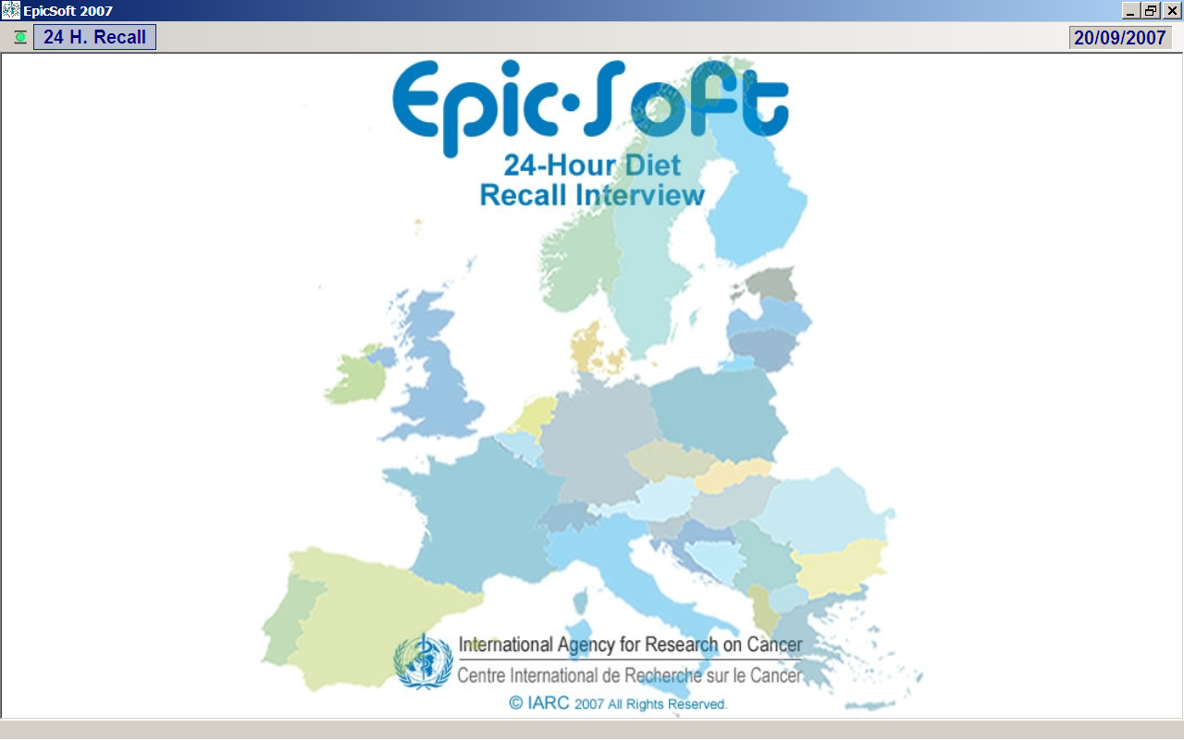

Slide 2
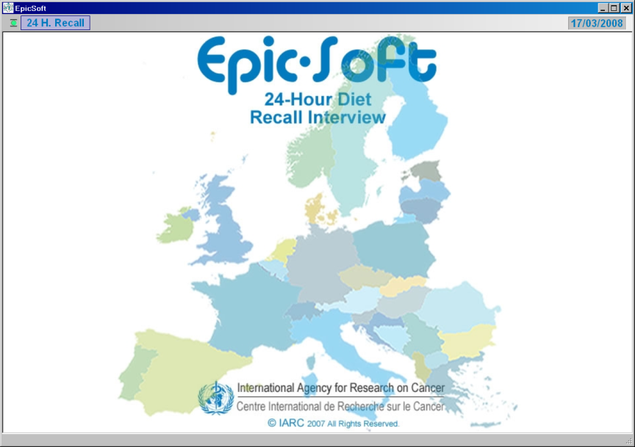

A common methodological for measuring & monitoring accurately diet across Europe
Highly standardised and detailed 24-HDR method across EU countries (18 versions)
Same general concept and user’s interface
Adapted version for children and potentially elderly people (Data entry system)
Comprehensive quality controls (before, during and after interview collection)
Validated for face-to-face and telephone interview alternatives
Tested in different study designs & populations
Standardised e-training facilities (ongoing)
Methodological papers (concept, validation)
Descriptive EPIC papers on food & nutrient intakes/patterns
(First set of EU comparable data at food and nutrient level)
Other papers outside EPIC (e.g. EFCOVAL special issue)
EPIC diet-disease association papers
(EPIC-soft as reference calibration method)
Notes:
In its broad definition, EPIC-Soft is a Highly standardised and detailed 24-HDR method across EU countries
Same general concept and user’s interface
Adapted version for children and potentially elderly people (Data entry system)
Comprehensive quality controls (before, during and after interview collection)
Validated for face-to-face and telephone interview alternatives
Tested in different study designs & populations
Standardised e-training facilities (ongoing)
Several douzens of papers on the concept, validation, first set of comparable data available in Europe.

Slide 3
Overall concept of standardization of EPIC-Soft
Common EPIC-Soft food or recipe classification
Common files
Level of description
Type of
quantification
methods
Probing
questions
Algorithms
Content of
screens
Food and
recipe lists
Translated
Epic-soft screens
Country-specific files
Specific level
of description
Specific
quantification
methods
Specific
probes
Specific
coefficients
Country-specific EPIC-Soft versions (~ 70 databases)
Notes:
3
The overall ad hoc concept developed to standardize the EPIC-SOFT 24-HDR program between the EPIC countries relied on two contradictory objectives.
Having a rigid system to ensure a high level of standardization in the interview procedure to prevent or minimize systematic errors, through common files controlling for common procedures and rules to describe, quantify, probe and calculate food consumption, including common screens and functions.
Having a flexible system to capture the large within and between country variation in food consumption. Through country-specific files taking starting from country-specific food and recipe files build up according the common rules summarized in the common files.
This approach enable to prepare 10 country-specific versions of the EPIC-SOFT programme, and, more recently, an additional one for Belgium not participating in EPIC.

Slide 4
EPIC-Soft: Overall structure
General information
General information
Quick list (QL)
Search, Description, Quantification, Probes
Overall controls
Dietary supplements

Slide 5
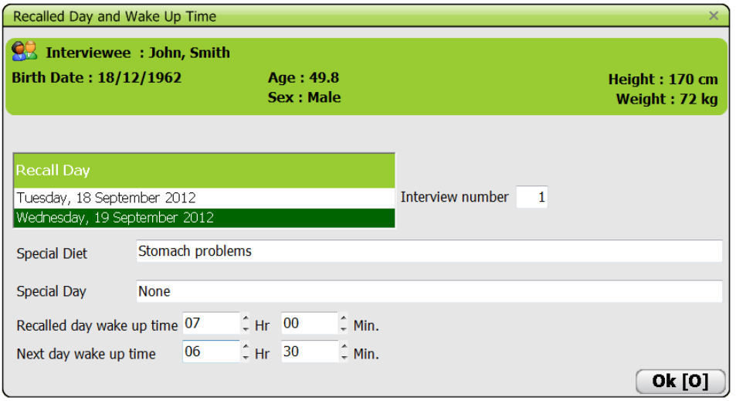
EPIC-Soft: General Information (24-HDR day)

Slide 6
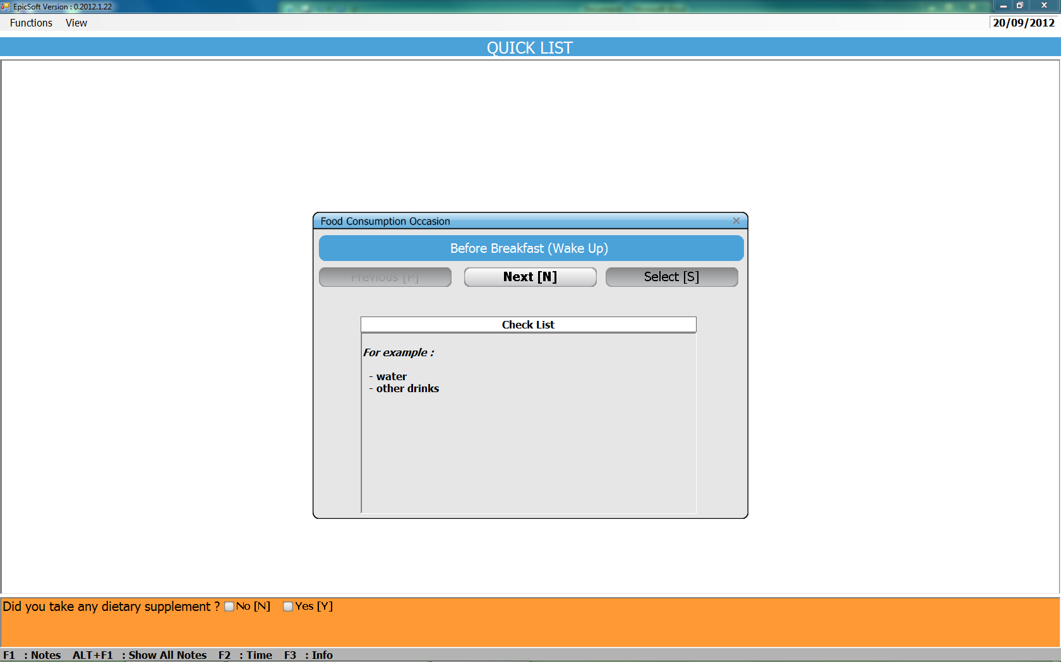
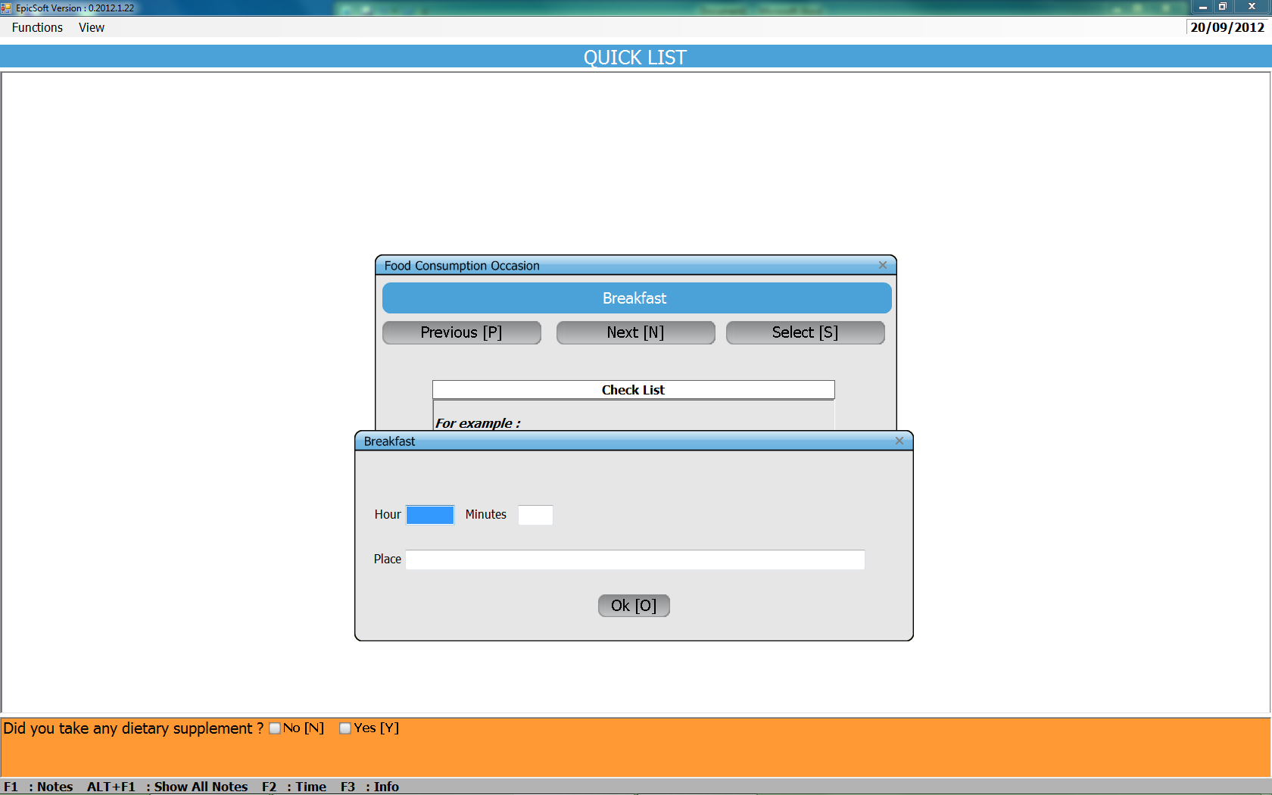
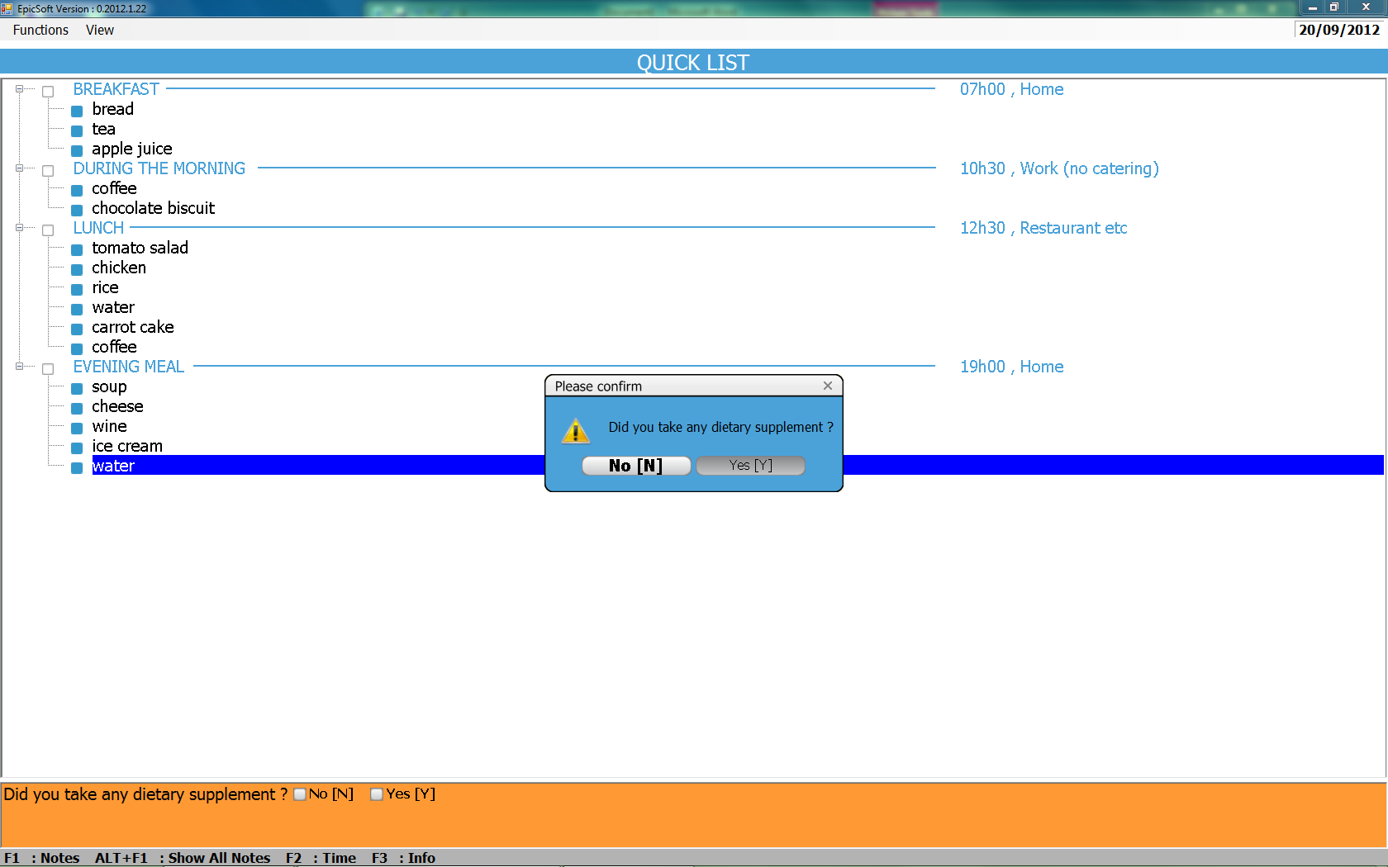
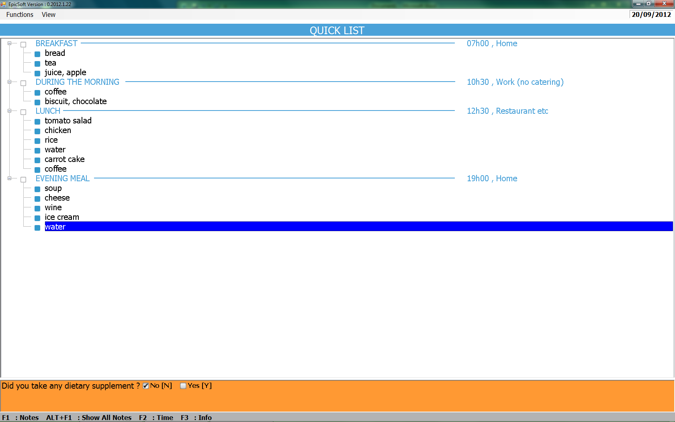
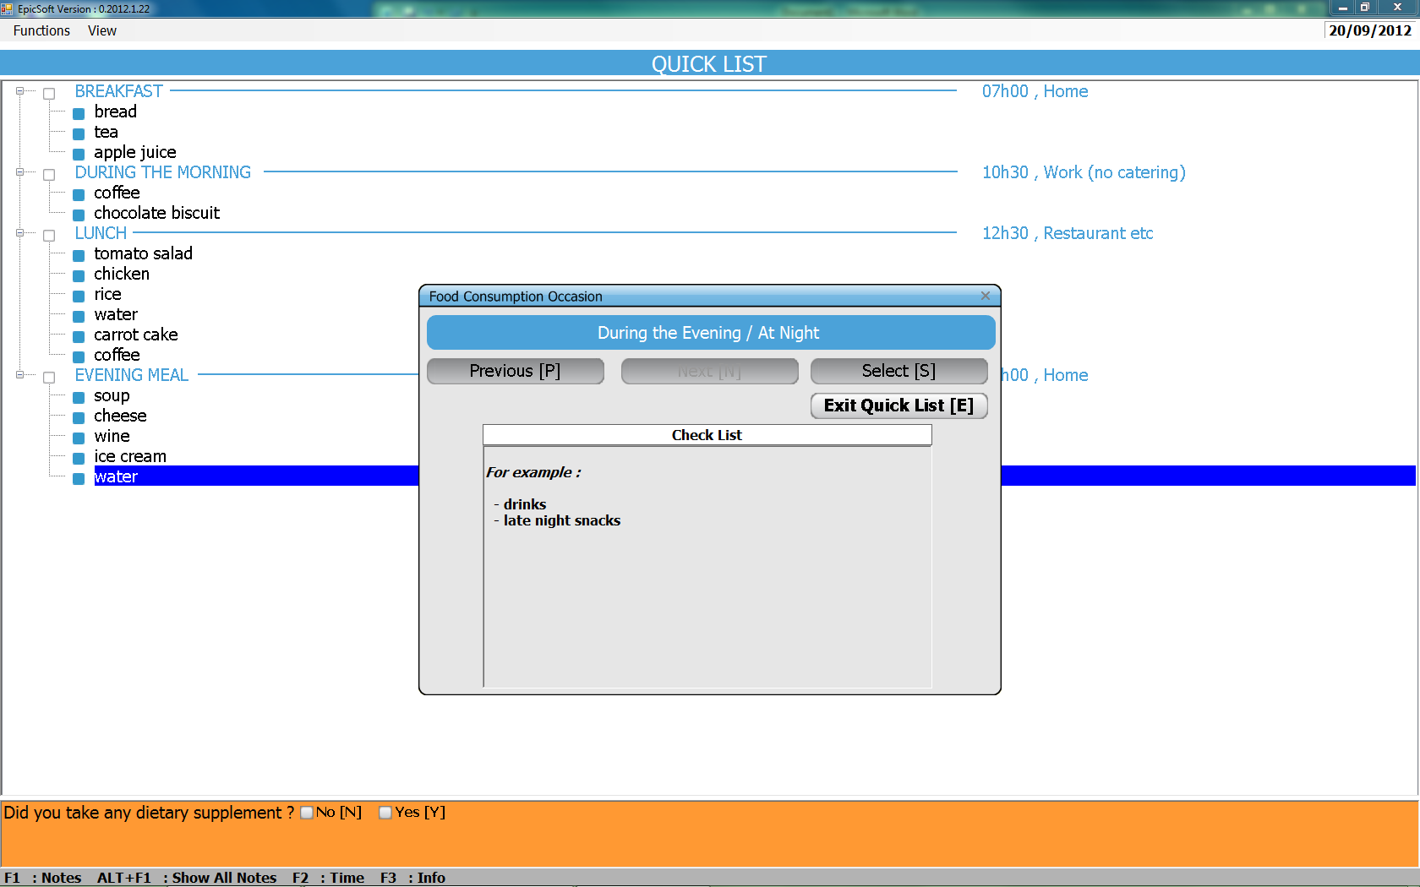
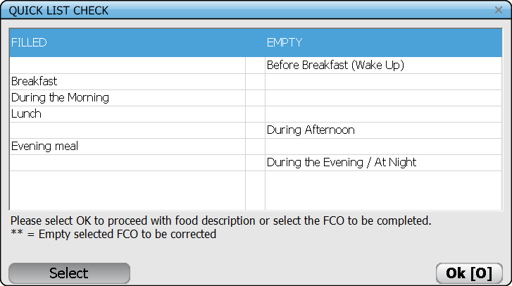
EPIC-Soft: Quick list

Slide 7
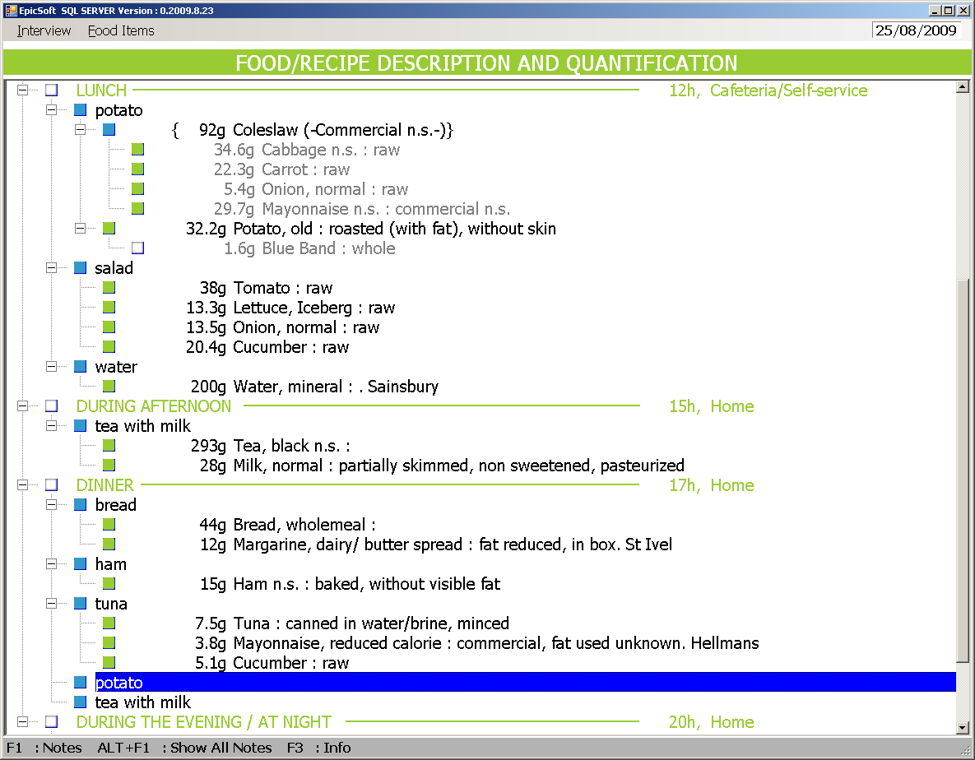
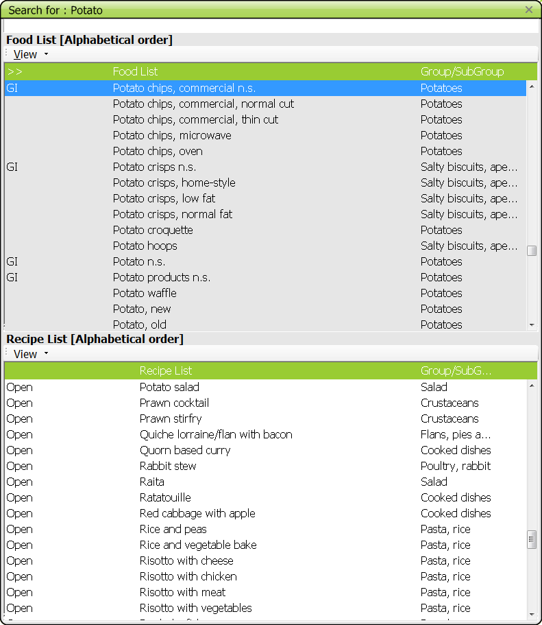
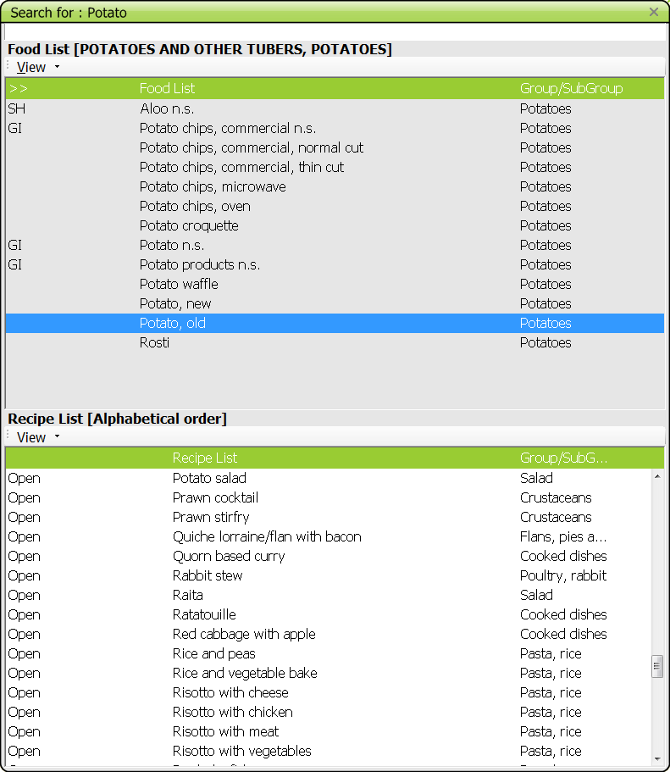
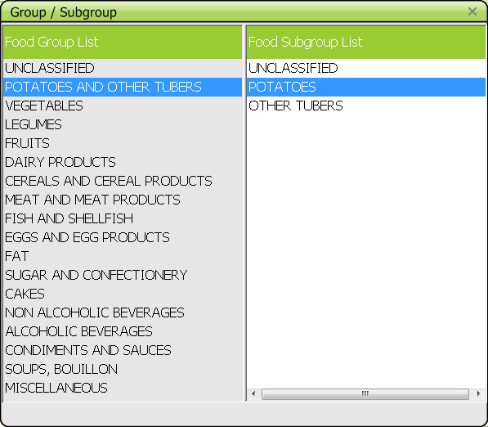
EPIC-Soft: A flexible descriptive system
Notes:
ES is a standardised tool which
- share the same interface and general concept across country-versions and standardised procedures to collect, search, describe, quantify, probe, calculate, export and maintain 24-Hdr recalls within and between countries.
- all the detailed information is systematically collected, stored and entirely retrievable
- As an example, the identification, search and level of description of the foods consumed by the study subjects is controlled by using the same sets of questions (facets such as preservation method, physical state, cooking method, skin consumed) and their related precoded answers of descriptors (e.g. different baked, fried, etc…) specific to each facet

Slide 8
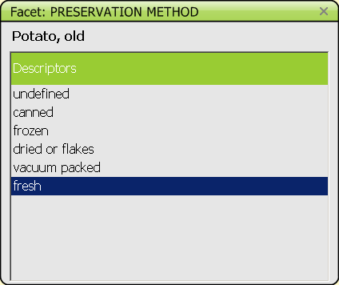
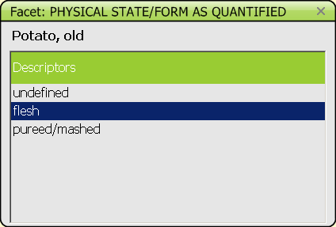
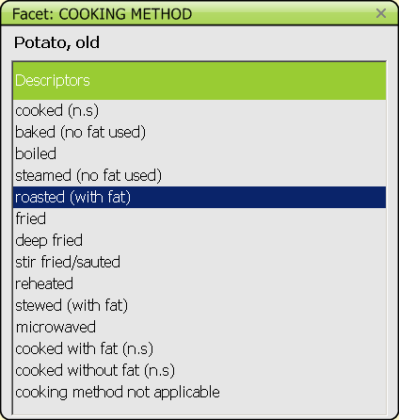
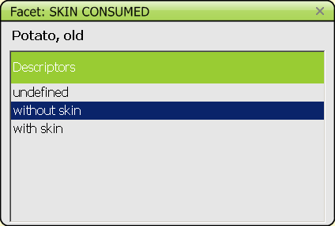
EPIC-Soft: A flexible descriptive system
Possibility to add:
New food
New recipe
New facet
New descriptor
Notes:
ES is a standardised tool which
- share the same interface and general concept across country-versions and standardised procedures to collect, search, describe, quantify, probe, calculate, export and maintain 24-Hdr recalls within and between countries.
- all the detailed information is systematically collected, stored and entirely retrievable
- As an example, the identification, search and level of description of the foods consumed by the study subjects is controlled by using the same sets of questions (facets such as preservation method, physical state, cooking method, skin consumed) and their related precoded answers of descriptors (e.g. different baked, fried, etc…) specific to each facet

Slide 9
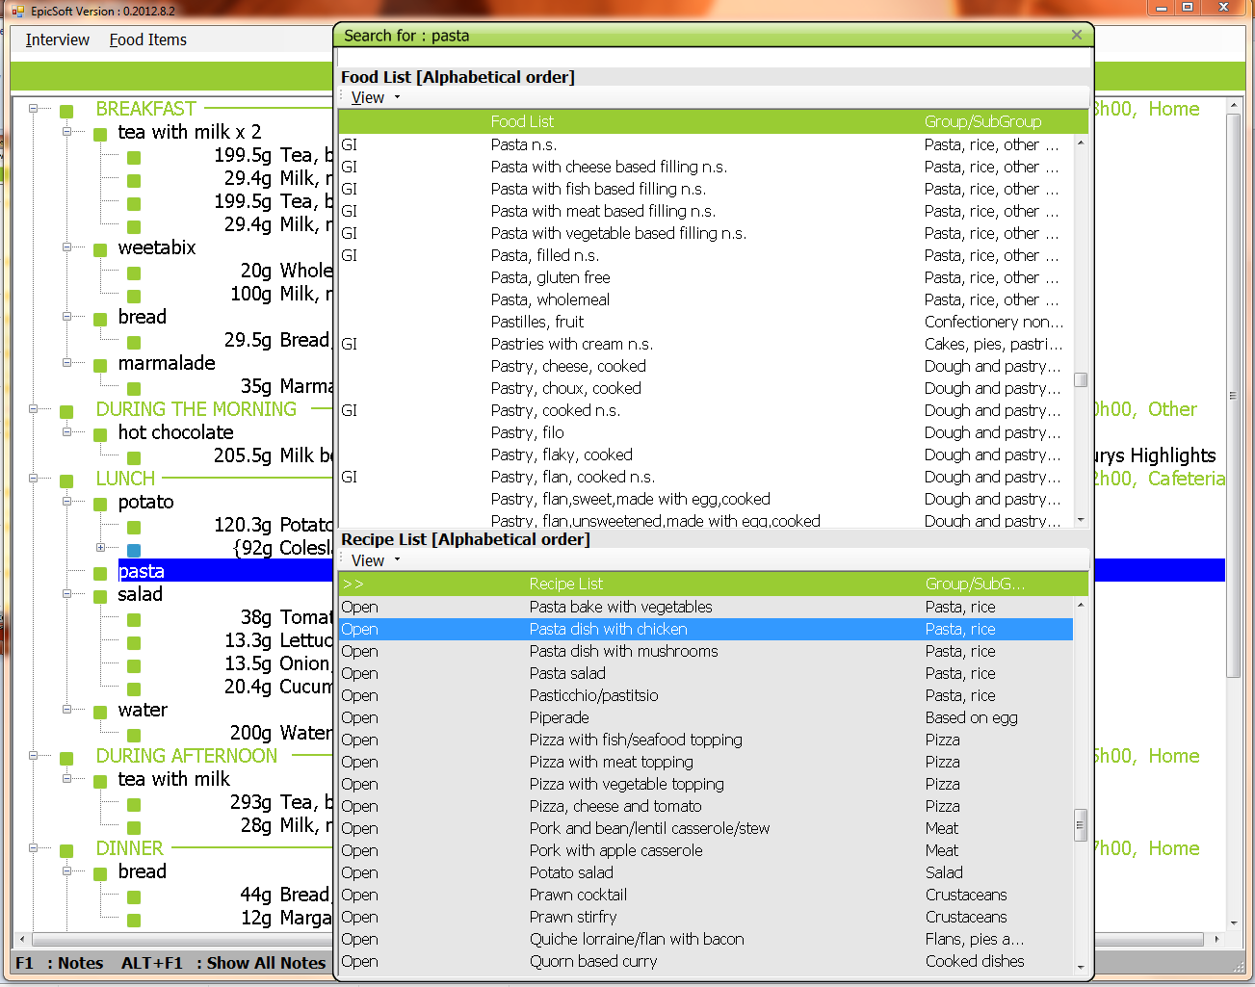
EPIC-Soft: A powerful recipe handling system

Slide 10
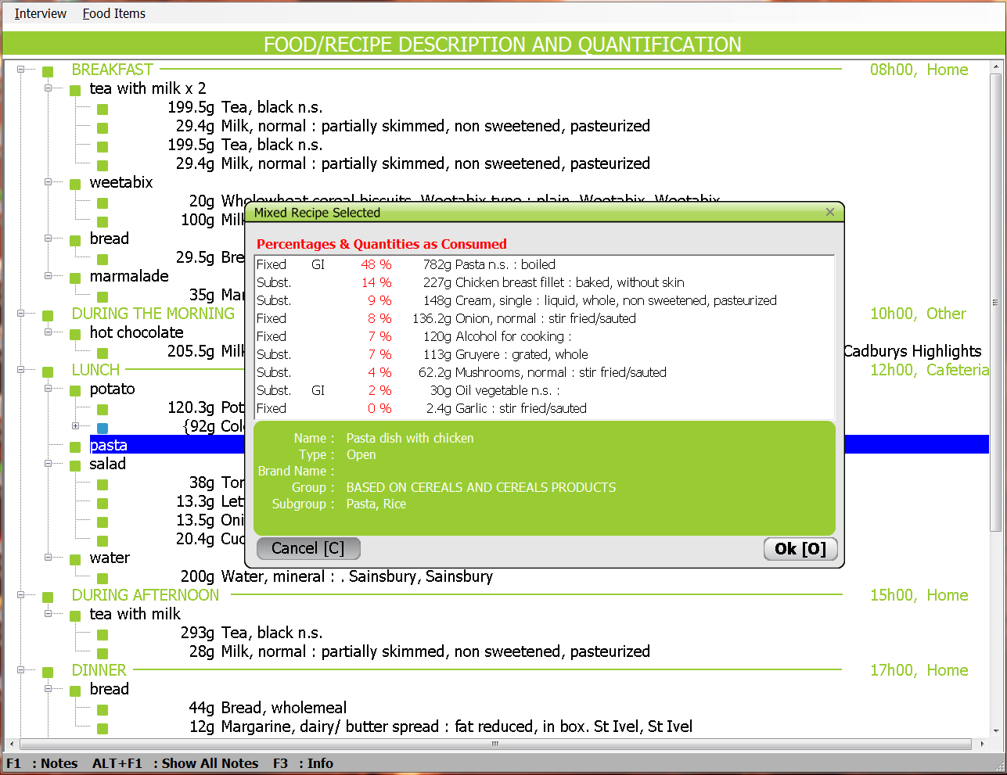
EPIC-Soft: A powerful recipe handling system

Slide 11
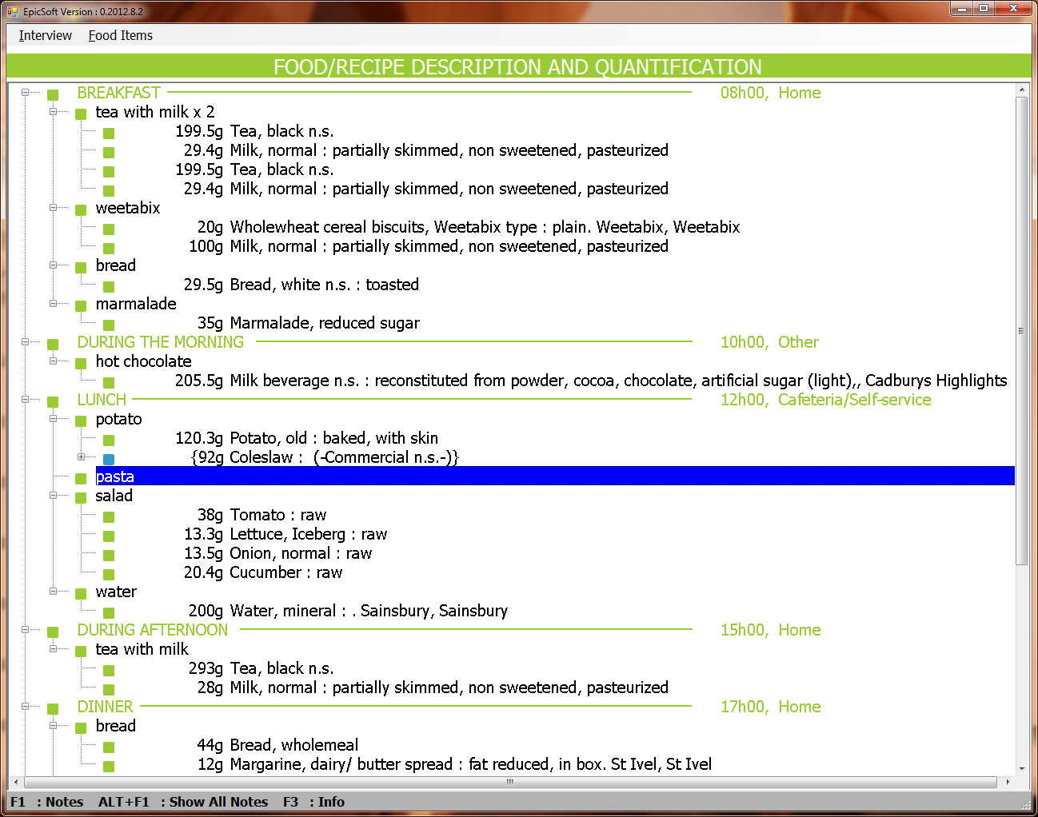
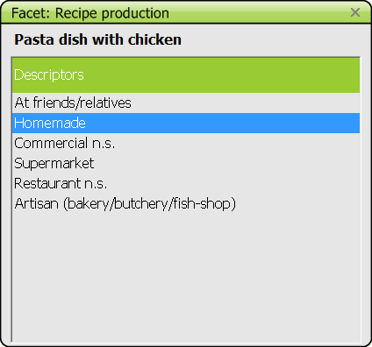
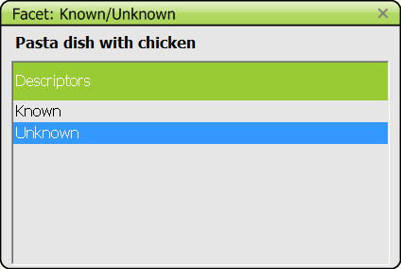
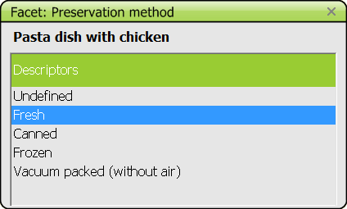
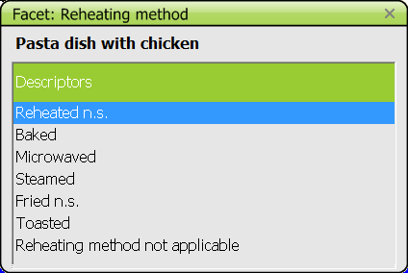
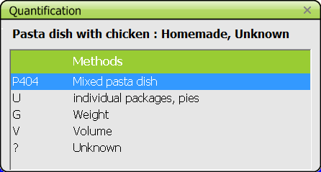
EPIC-Soft: A powerful recipe handling system

Slide 12
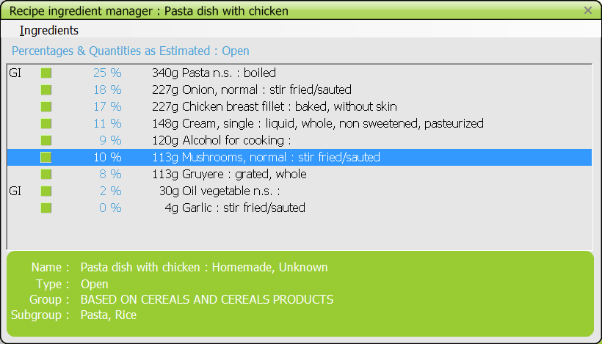
EPIC-Soft: A powerful recipe handling system
Possibilities to:
- re-describe ingredients
- Substitute ingredient by another one within the same group/subgroup
- Add or delete ingredients with appropriate recalculation and quality controls

Slide 13
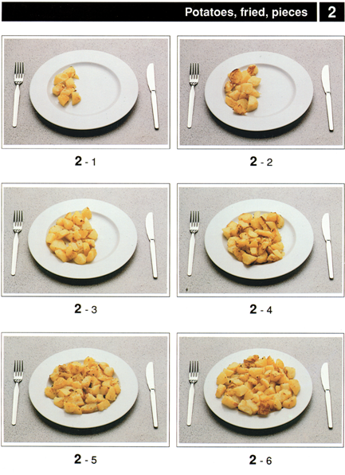
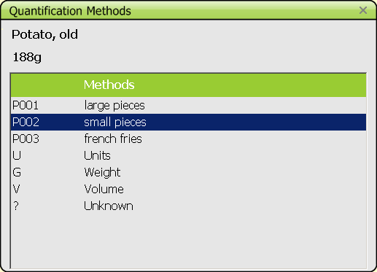
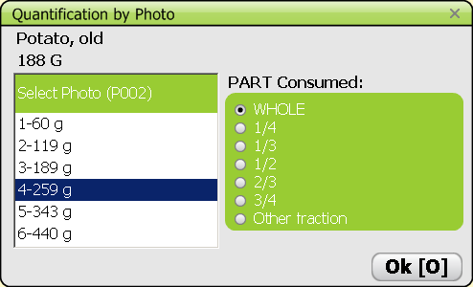
EPIC-Soft: Food/Recipe Quantification
Quantification methods

Slide 14
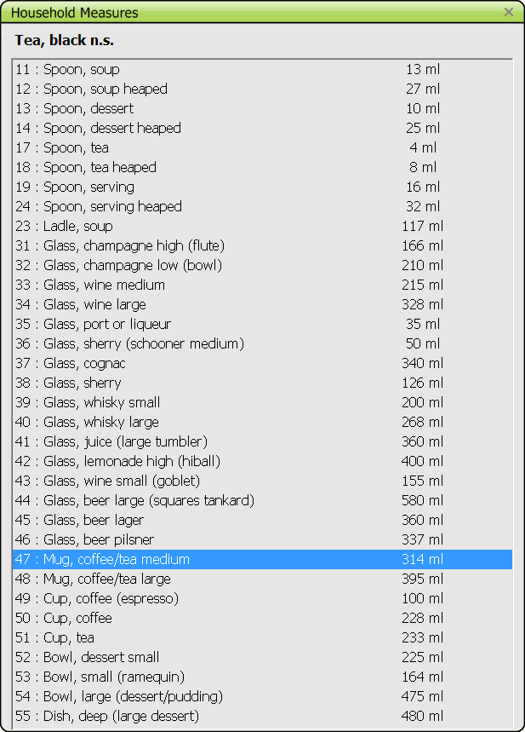
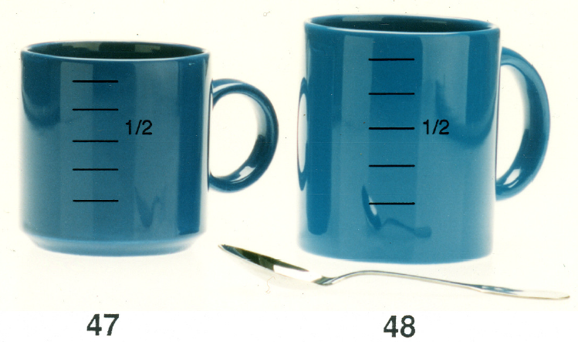
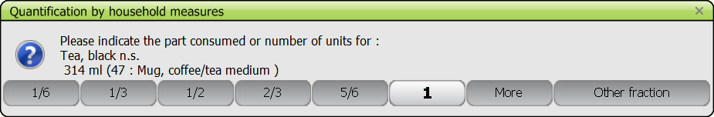
EPIC-Soft: Food/Recipe Quantification
HHM

Slide 15
EPIC-Soft: Quality controls
Before the interview (EPIC-Soft database versions)
During the interview (Interview data collection)
After the interview (Interview data cleaning and analyses)

Slide 16
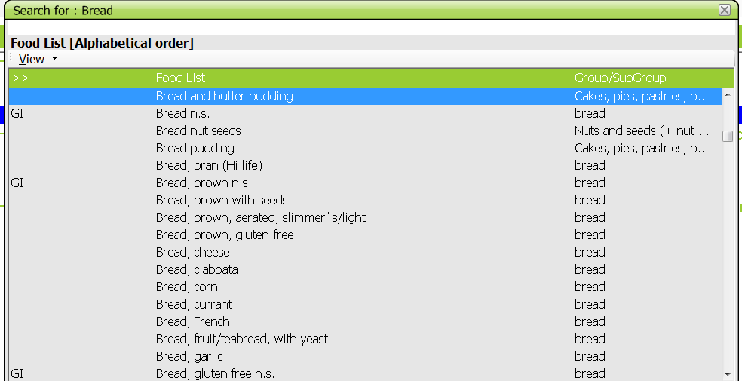
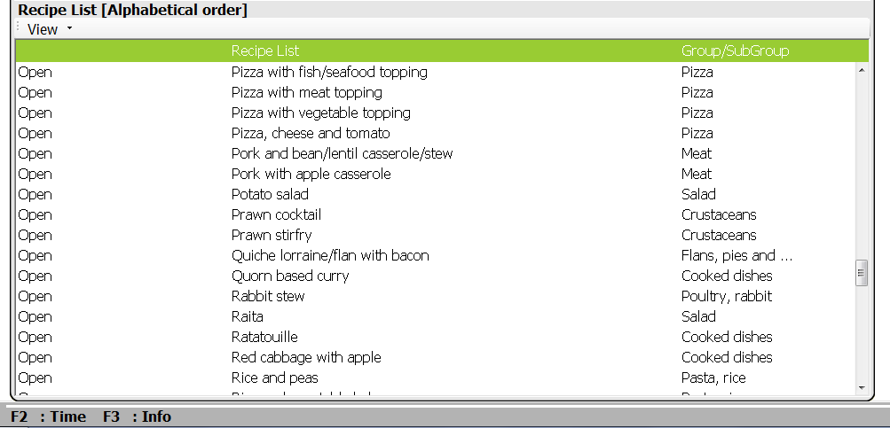
EPIC-Soft: Quality control before interviews
Pre-defined lists of foods and recipes available in the system
Notes:
New items can be entered. These are flagged so they can subsequently be checked and possibly added to the food/recipes databases. (Attention: they can replaced by other foods in the list that were not found by the interviewer before)
A series of non specified generic foods and descriptors can be used during the interview to avoid arbitrary decisions.

Slide 17
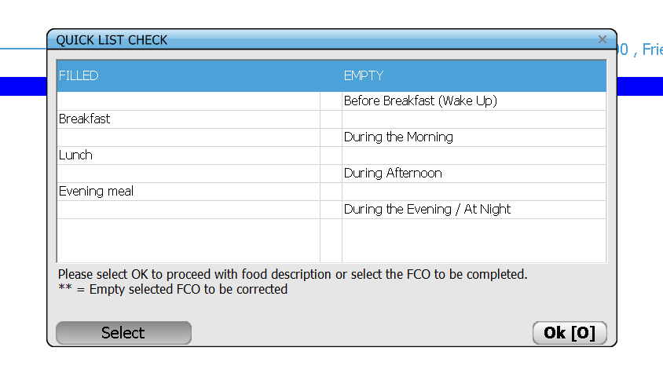
EPIC-Soft: Quality control during interviews
At the end of the quick list, a screen is shown to check for any forgotten occasion
4 occasions are empty: Correct?

Slide 18
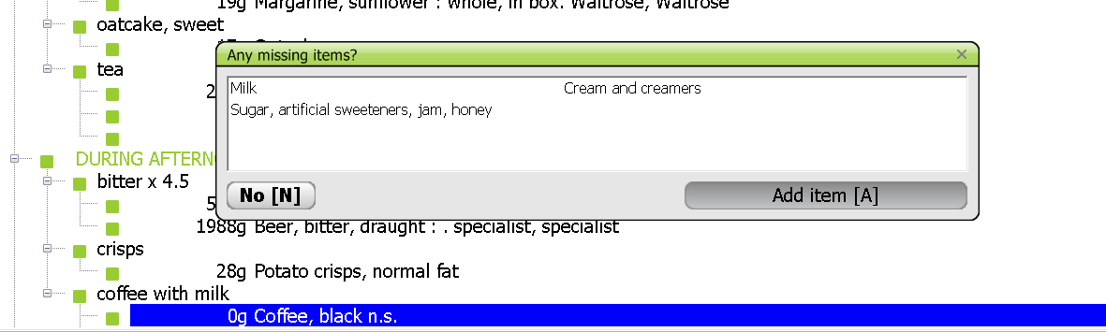
EPIC-Soft: Quality control during interviews
Use of automatic probing questions during the interview
For instance, at the description and quantification of each food or recipe
Notes:
=> Probing questions during quick list items are specific to food consumption occasion

Slide 19
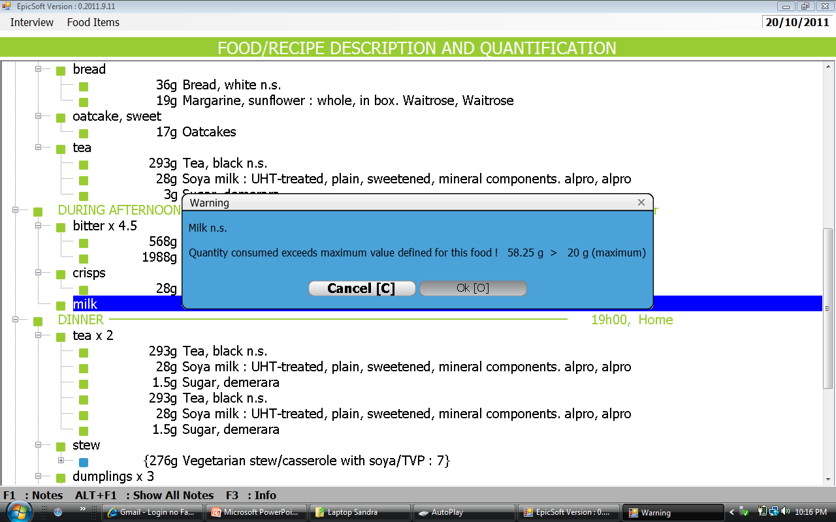
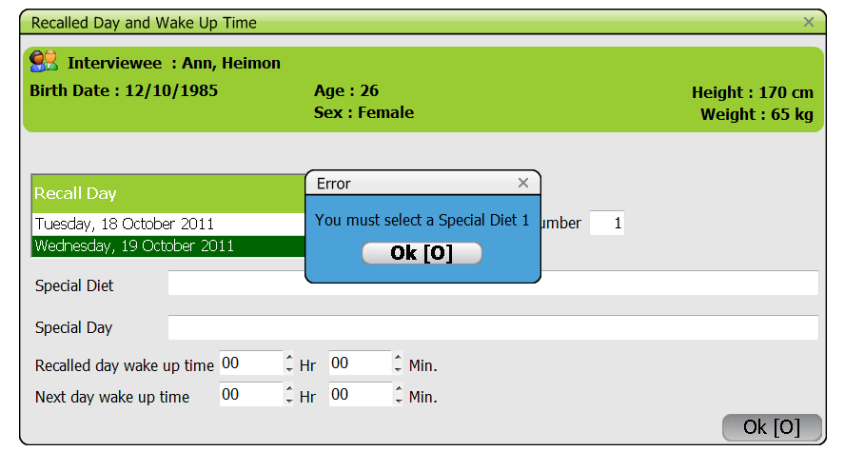
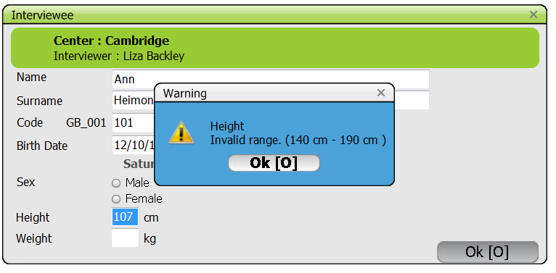
EPIC-Soft: Quality control during interviews
System can automatically check for empty fields or extreme values entered
Milk in powder
→ range value check
Notes:
Mention example of milk in powder and in liquid.

Slide 20
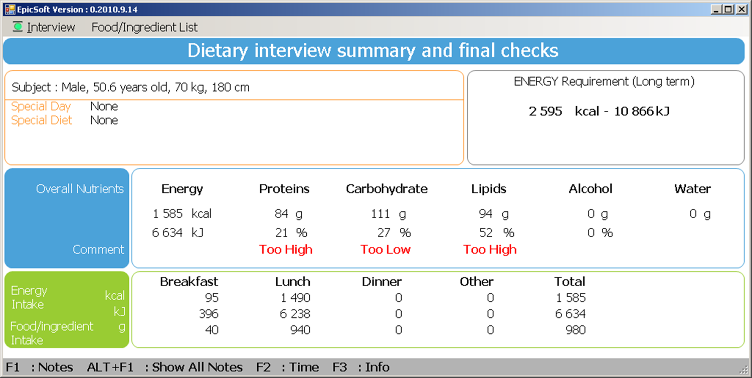
EPIC-Soft: Final Quality Controls
Interview steps
IARC, Lyon - France
EPIC-Soft training:

Slide 21
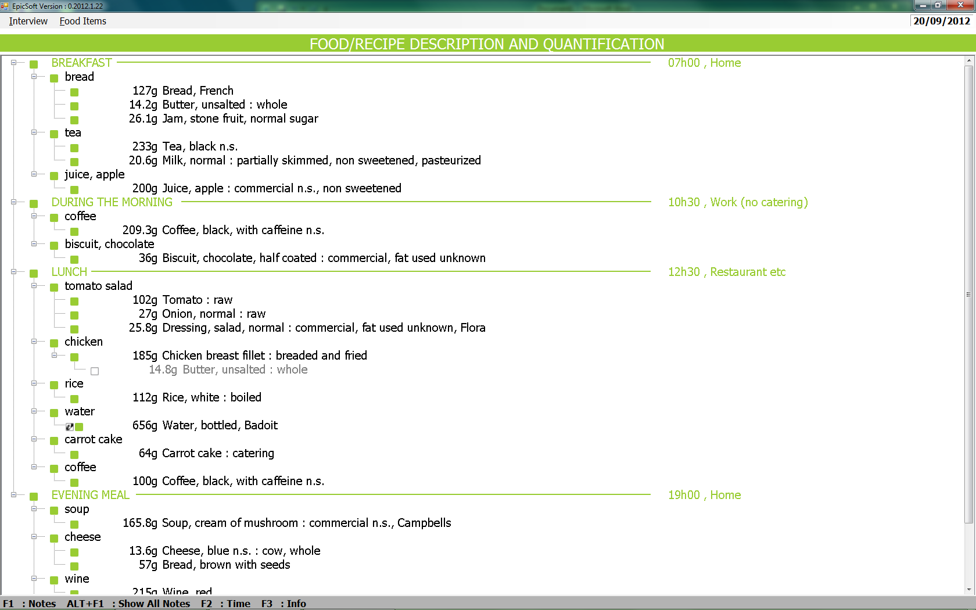
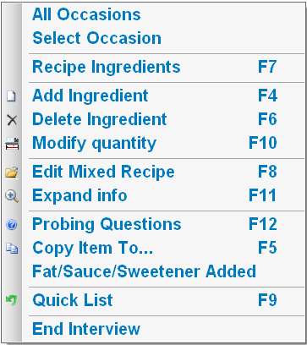
EPIC-Soft: Final information
All the dietary information collected is systematically coded, retrievable and
exported according to common formats and procedures

Slide 22
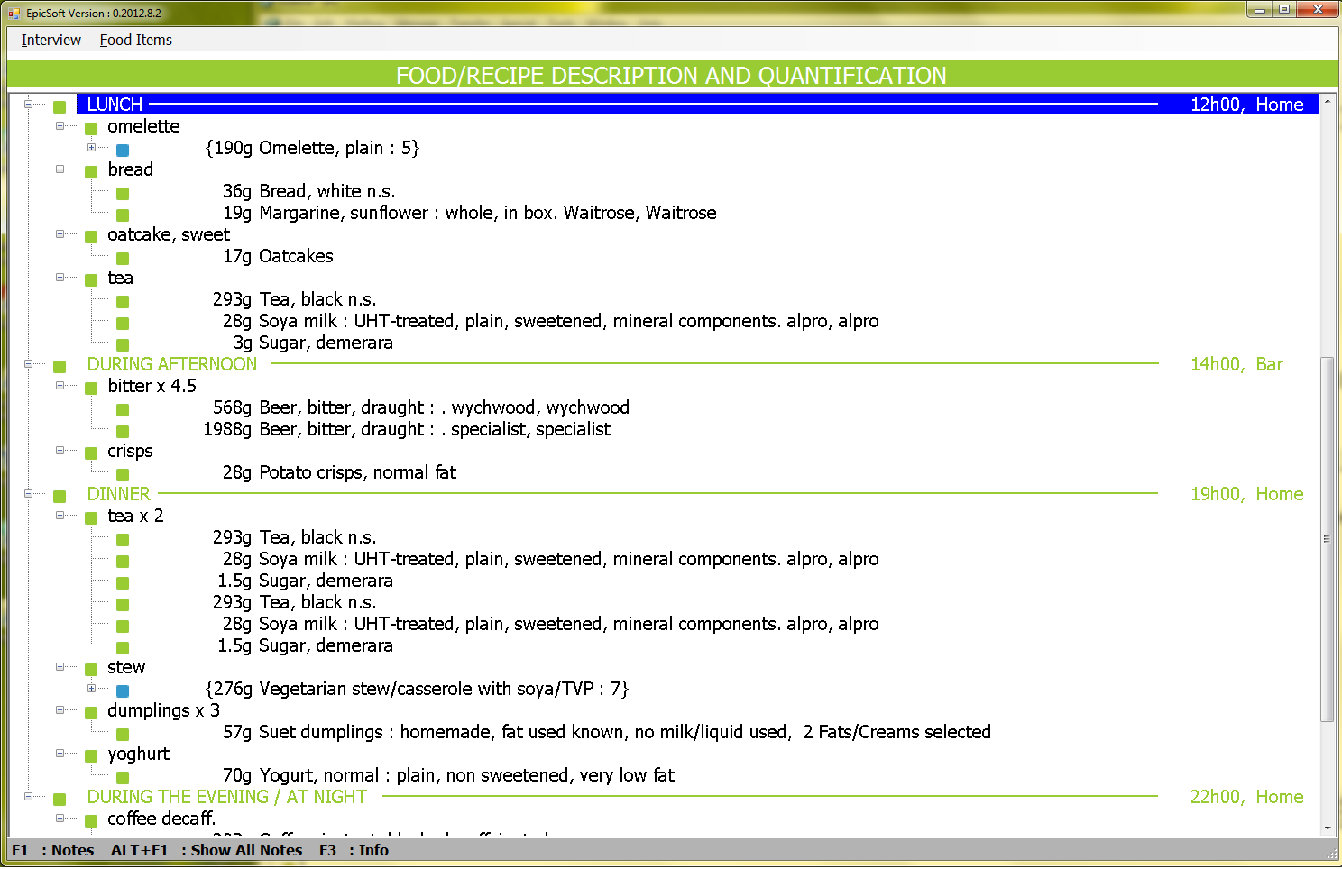
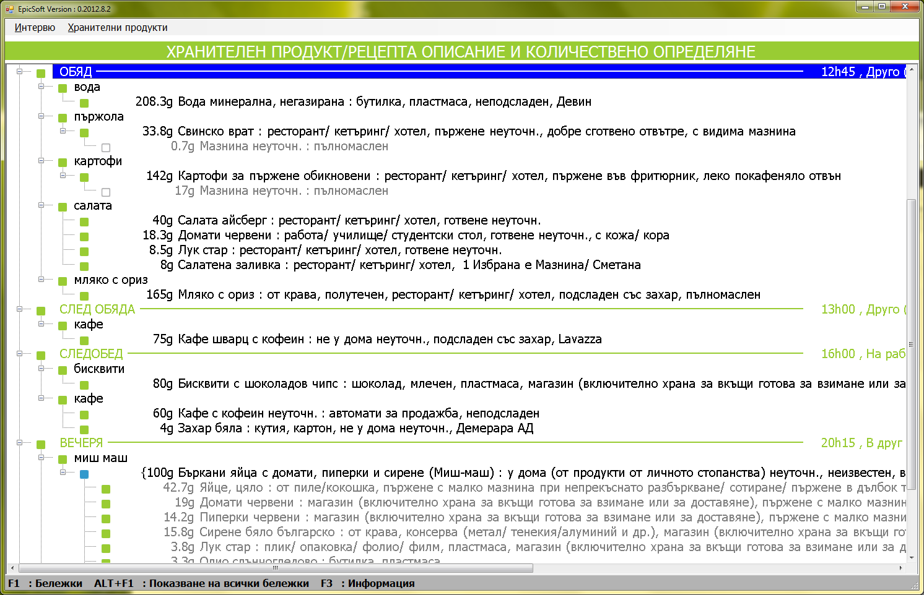
EPIC-Soft: an international tool

Slide 23
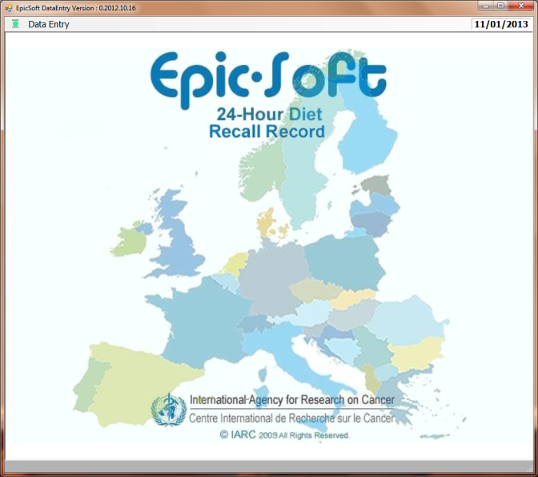
EPIC-Soft Data Entry
EPIC-Soft has been adapted for data entry of repeated (consecutive) days of food consumption data as collected by food diaries.
This new application called EPIC-Soft Data Entry
The main differences with EPIC-Soft are the possibility to:
Enter a specific data or record
Skip the “Quick list” step
Not use the probing approach
Standardization concept of EPIC-Soft is kept
Collected data are comparable/identical with data collected with EPIC-Soft in terms of details of description, quantification, export formats...

Slide 24

e-SMP
e-Standardised Methodologies Platform
(on-going)
A Web-Research infrastructure:
General concepts and progress report
Notes:
- Template du CIRC
Full name e-SMP

Slide 25
e-SMP: Rationale
24-HDR method as the EPIC-Soft® program, is a detailed and dynamic open-ended method requiring regular and rigorous database maintenance;
The database maintenance is of equal importance in the overall standardisation process, but frequently underestimated;
Benecifing from new technologies all maintenance approaches need to be replaced by comprehensive and strong (web-) infrastructure supports
Need strong infrastructure to balance two contradictory objectives: standardisation (centralised model) vs. dissemination (federated model)
Need to preserve concept of standardisation and integrity of the EPIC-soft dietary methodology over time;
IARC, as an International non-profit WHO-UN organisation and owner of the e-SMP (including EPIC-soft methodology), has as main mission to disseminate knowledge, with priorities to international applications
Notes:
25

Slide 26
e-SMP: General Aims
Security, Users & Projects Management, Data Protection
Administration
Administration
Maintenance & Setting
Interview Management
Create, Edit & Export EPIC-Soft Databases
Communication
Centralize, Organize, Edit (notes, status) & export EPIC-Soft interviews
International
International
National
Project
National
Project
National
National
Local
Admin
Project
Local
Admin
Admin
Admin
Admin
Admin
Admin
Admin
Admin
Admin
Admin
Interview collection
EPIC-Soft and its Data-Entry Application
End
End-user
-
A platform to conduct and support international studies,
Standardise dietary methodology between countries and projects,
Preserve the concept of standardisation and integrity over time,
Cost-effective for countries with limited local technical resources and dietary skills;
Independence and flexibility for individual projects;
Facilitate communication and data synchronisation/exchange.

Slide 27
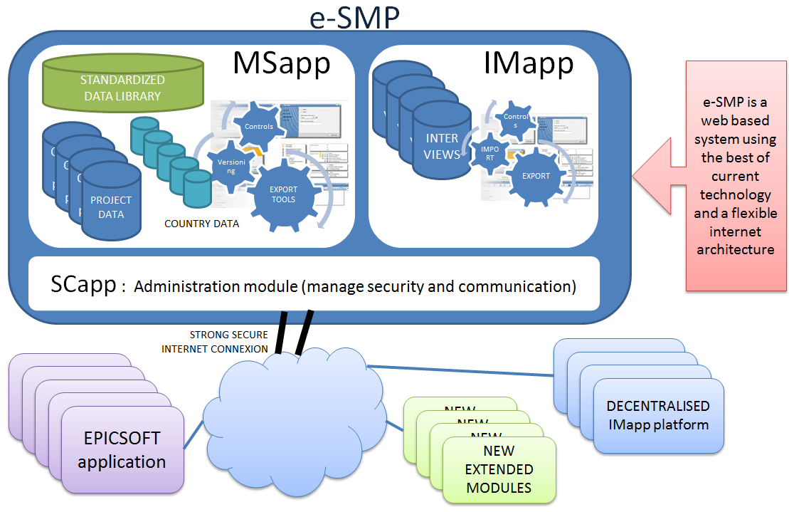
e-SMP: Global architecture
Notes:
27

Slide 28
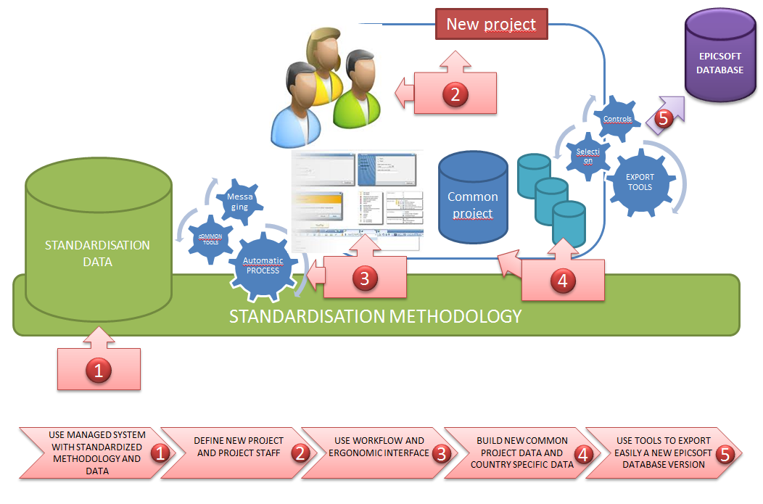
e-SMP: A comprehensive process
Notes:
28

Slide 29
e-SMP:A mixed infrastructure Model
Hosted ans managed by IARC
Decentralized interview data collection and storage
Maintenance & Settings
Create and manage EPIC-Soft versions
MSapp
MSapp
EPIC-Soft /
Data-entry
Interview Manager
IMapp
Collected
data
Library: Common data managed by IARC
Project data
Strong link with library data
Common data to all countries
Customized by project’s coordinators
Country data
Strong link with project data
Done by country coordinators
Link with other country data from the same or different projects
Export of EPIC-Soft database
Load EPIC-Soft database
Training of interviewers
Field work
Export interviews
Load and import interviews
Processing
View interviews and notes
Subjects management
Notes management
Use EPIC-Soft to correct interview data
Feedback to Maintenance & Settings to update project and country data
Export of interviews data for statistics analysis
Feedback from field-work

Slide 30



e-SMP: Dataflow
STANDARDIZED LIBRARY DATA
PROJECT & COUNTRIES DATA
Data cleaning/upgrade based on the individual NOTE file (created during field work)
Error corrections done in the Interview Manager or in EPIC-Soft
Updates of interviews are performed in (upgraded versions of) EPIC-Soft to benefit from the business logic implemented in EPIC-Soft
Updates of subjects are performed directly in Interview Manager
MSapp
IMapp
Admin
Admin
Notes handling
Interviews (raw/modified)
Interviews (raw/modified)
EPIC-Soft
Database
(~70 tables)
Interviews
(to be corrected)
Recipe manager
Data Export
for statistical analyses
Export the data in the universal CSV and XML formats for analysis in SAS, SPSS, R, Stata,
Highly detailed data
High quality data, cleaned and ready for analyses
EPIC-Soft Application
Data Entry Application
Notes:
Abbréviations et cohérence
30

Slide 31
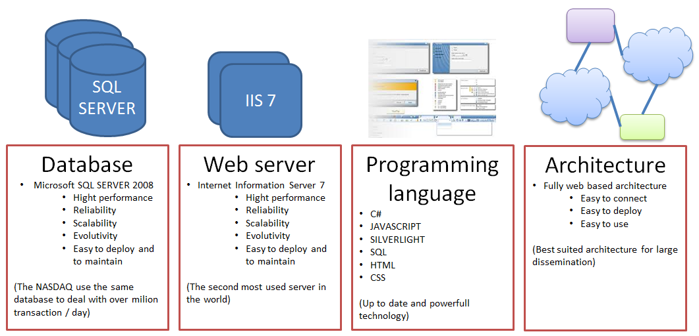
e-SMP: A robust infrastructure
Compliance with the best practices in design, coding and architecture
Robust, flexible and evolutive technology to adapt to heavy (IARC site) or light deployment (decentralised sites)
User-friendly interface, the more ergonomic and intuitive function

Slide 32
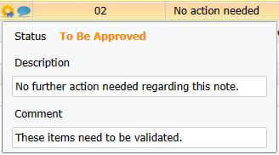
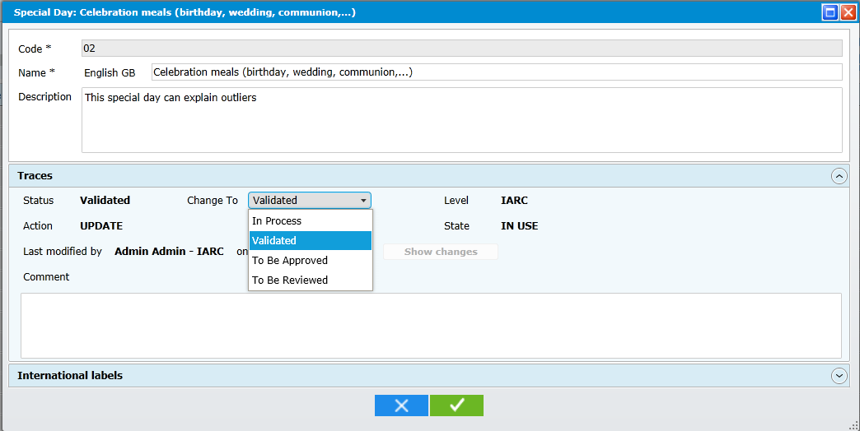

e-SMP: Collaborative framework
USER specific profiles (roles and access rights on e-SMP)
DATA status (“In Process”; “To be approved”, “To be reviewed”, “Validated”
DATA mode:
New: data not used in the field yet
In Use: data already disseminated
Archived: data disseminated but no longer proposed in the field
DATA tracing:
Who?
When?
Backup validated data before modification
Visual indicators
Comments and communication facilities using proven email infrastructures

Slide 33










e-SMP: Organizational infrastructure
International principal
Administrator/Coordinator
(IARC)
IARC library data
International project Administrators/Coordinators
(e.g. EFSA)
Interviews data
Project data
National Administrators/
Coordinators
Country data
Interviews data
Intermediate
Local
Coordinators
Country data
Interviews data
End-Users
Country data
Interviews data
Notes:
33

Slide 34






e-SMP: Communication
IARC
Send
alerts
Mail client
Receive
Send
Send
alerts
Project
Send
alerts
Send
alerts
Country
Country
Notes:
34

Slide 35

e-SMP: Communication
Communication facilities using proven email infrastructures
Notes:
Expliciter sur 1 ou 2 slide supplémentaires

Slide 36


e-SMP: A secured web-platform
User administration / handling
Notes:
Expliciter sur 1 ou 2 slide supplémentaires

Slide 37

e-SMP: A user-friendly interface
Header
General information about the platform and its status (user connected and perimeter selected).
Menu
Gives access to all screens of the applications.
Actions icons
Create and add
View and edit
Comment
Send alerts and messages
Import
Export
Control
Access to help
Navigation
Shows the screens currently opened.
Content
Working area of the active screen.
Notes:
Icônes:
+ add
37

Slide 38



e-SMP: Search
The “SEARCH” facility allows to select specific data to be displayed on the screen according to the defined criteria.
e.g.: Specific criteria used for the SEARCH are “REGION” and “GENDER”
Notes:
Search, filter and sorting are general principles that you want to show for e-SMP? Because now it is not clear how to get the search screen that you are showing or how to come to the filters … so I presume that you are only showing the general principles?
38

Slide 39






e-SMP: Filter
The “FILTER” facility allows to display a data subset. These filters can then be saved and re-used.
e.g.: Specific criteria used for the FILTER are records with a “NOTE status” as ’00 - New’ and a “NOTE type” ‘Food’. This set of criteria is then saved as “New notes concerning foods” and re-used.

Slide 40



e-SMP: Sorting
In all lists of the application it is possible to sort the data by clicking on the desired header. It follows the cycle: default (as it was originally), ascending order, descending order.

Slide 41



e-SMP: Column selection
Possibility to select COLUMN(S) to be displayed by RIGHT CLICKING anywhere in the headers of the list
e.g.: Here display only 7 out of 17 possible columns.

Slide 42
e-SMP: Exported Data
Data exported in standardized CSV and XML formats for statistical analyses
Complete and detailed export: all collected and calculated data are included (no retention of information)
The combination of the controls done during the interview, the use of the recompute and the handling of the notes make the exported data fully cleaned and ready for consumption.
The high quality of the produced data makes it easy to merge different countries and/or projects.
Data collected/to be used as a “library”
Nutrient and other food component databases to be handled outside

Slide 43
e-SMP: Training and guidelines
e-documentation, e-learning, Webinar, online help (video, tooltip, fixed comments)
For EPIC-Soft & Data-Entry
IARC’s Train the trainers (English, IARC)
Local training, specific for dietician (local language, local coordinator)
For e-SMP (web platform) is on-going

Slide 44
e-SMP: Where do we stand now?
Deployment/Documentation
Planification
Conception
Implementation
Test (incl. campaigns)
Maintenance
Evolution
EPIC-Soft
EPIC-Soft
EPIC-Soft
EPIC-Soft
EPIC-Soft
EPIC-Soft
EPIC-Soft
E-SMP Web platform
E-SMP Web platform
E-SMP Web platform
E-SMP Web platform
E-SMP Web platform
E-SMP Web platform
E-SMP Web platform
Administration
Administration
Administration
Administration
Administration
Administration
Interview Manager
Interview Manager
Interview Manager
Interview Manager
Interview Manager
Maintenance
& Settings
Food management
Food management
Food management
Food management
Recipe management
Recipe management
Recipe management
Supplement management
Supplement management

Slide 45

















Acknowledgements
Task Force
Group
e-standardized Methodology Platform (e-SMP)
Users
IARC/DEX
Angeline Coinon
Ariane Dufour
Arpad Ambrus
Carine Dubuisson
Carolin Krems
Caroline van Rossum
Davide Arcella
Henny Brannts
Herman Van Oyen
Jan van der Laan
Jean-Luc Volatier
Jiri Ruprich
Juergen Koenig
Liisa Valsta
Marcela Dofkova
Marga Ocké
Marja-Leena Ovaskainen
Maryse Niekerk
Mia Bellemans
Mieke de Maeyer
Peggy Pinard
Petra Rust
Sofia Guiomar
Stefan Muri
Stefanie Van de Vijvere
Group Head: | Dr Nadia Slimani
Scientists: | Dr Inge Huybrechts Dr Heinz Freisling
Food Chemist/ Nutritionist: | Ms Geneviève Nicolas Ms Viktoria Knaze
Post-Docs: | Dr Jin Young Park Dr Sandra Crispim Dr Pedro Pisa Dr Anne-Kathrin Illner
Database manager: | Ms Corinne Casagrande
Secretary: | Ms Nicole Suty
External IT team
ITEAL (e-SMP)
Ph. & G. Grange (EPIC-Soft)
Internal IT team
IARC’s IT service (ITS group)

